Slide 1
Pregnant diabetes

Slide 2
Prepared By :
Leen Mahdi – 202111095
Nagham Alotaibi – 202110560
Shaden alkarouf – 202111349
T
0

Slide 3
An overview of the topic of Pregnant diabetes
T
1

Slide 4
An overview
Gestational diabetes is high blood sugar in a pregnant woman who was not previously diagnosed with diabetes before pregnancy.
Gestational diabetes can appear at any stage of pregnancy .
T
1

Slide 5
Causes of gestational diabetes
1
Women over 25 years old
2
Who has a family history of type 2 diabetes
3
overweight
T
1

Slide 6
dataset that was chosen
T
2

Slide 7
Pregnant diabetes data set
dataset
Link about dataset :
https://www.kaggle.com/datasets/mathchi/diabetes-data-set
SHAPE: (768,9)
T
2

Slide 8
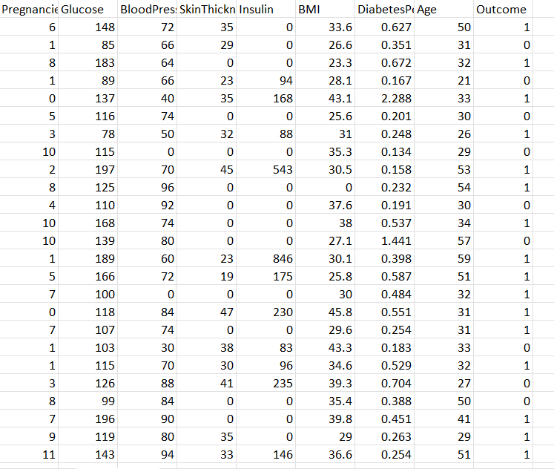
Dataset
T
2

Slide 9
What is in the dataset ?
Pregnancies: Number of times pregnant
Glucose: Plasma glucose concentration a 2 hours in an oral glucose tolerance test
BloodPressure: Diastolic blood pressure (mm Hg)
SkinThickness: Triceps skin fold thickness (mm)
Insulin: 2-Hour serum insulin (mu U/ml)
BMI: Body mass index (weight in kg/(height in m)^2)
DiabetesPedigreeFunction: Diabetes pedigree function
Age: Age (years)
Outcome: Class variable (0 or 1)
T
2

Slide 10
DATA CODES
T
4

Slide 11
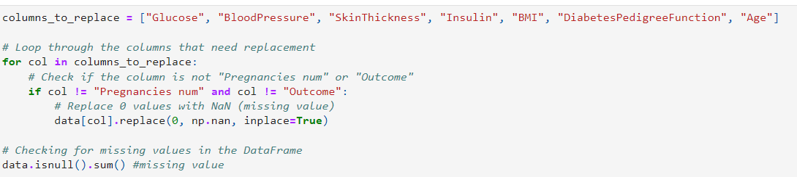
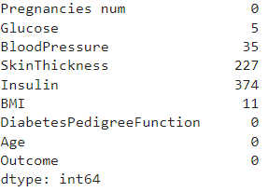
How many missing (NaN) values are there in each column of the dataset after replacing 0 values with NaN for the specified columns?
Output
T
5

Slide 12
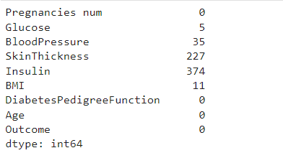
Fill missing values with the mean of each column
Output
T
5

Slide 13
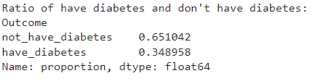
What is the ratio between individuals who have diabetes and those who do not have diabetes based on the "Outcome" column in the dataset?
Output
T
5

Slide 14
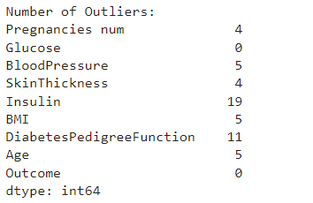
How many outliers are there in each column of interest based on the Z-scores calculated using a threshold of 3 for outlier detection?
Output
T
6

Slide 15
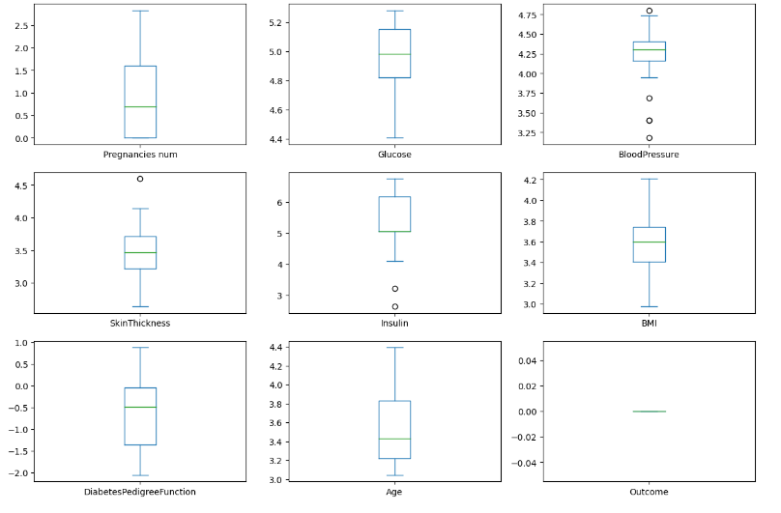
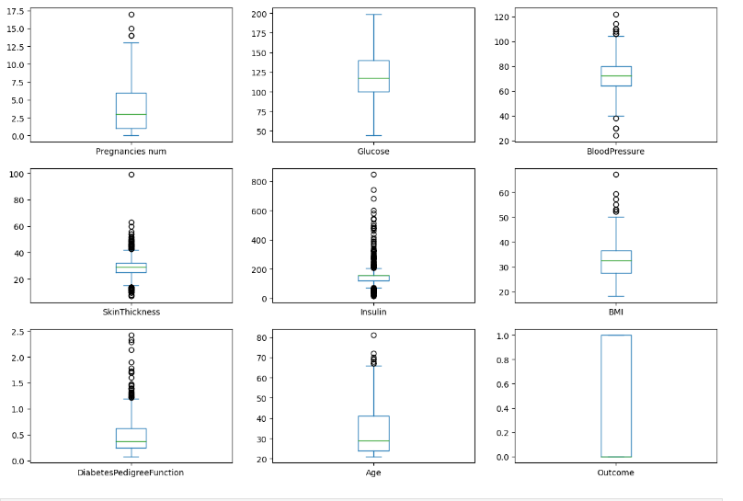
box plot for each column in the log-transformed to visualize the distribution and identify any potential outliers after applying the natural logarithm function?
box plot for each column with outliers
T
6

Slide 16
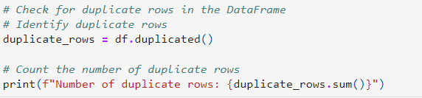
How would you identify and count the number of duplicate rows in a DataFrame ?
Output
T
6

Slide 17
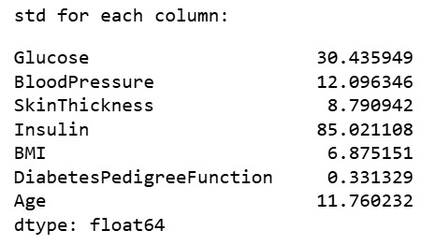
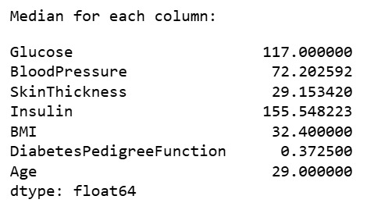
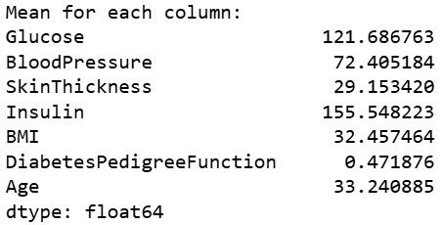
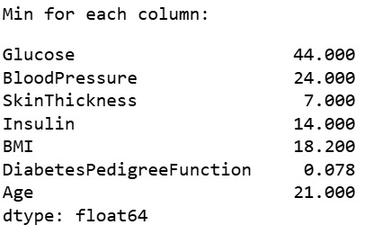
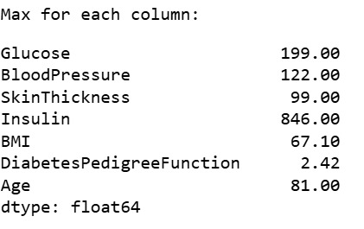
T
6

Slide 18
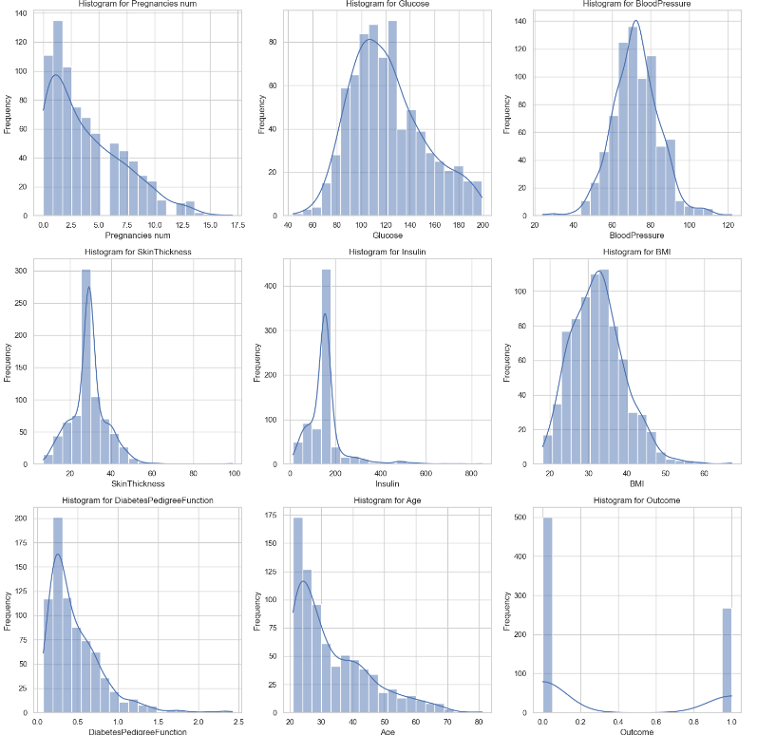
How do the distributions of numeric columns in the dataset look when plotted as histograms?

Slide 19
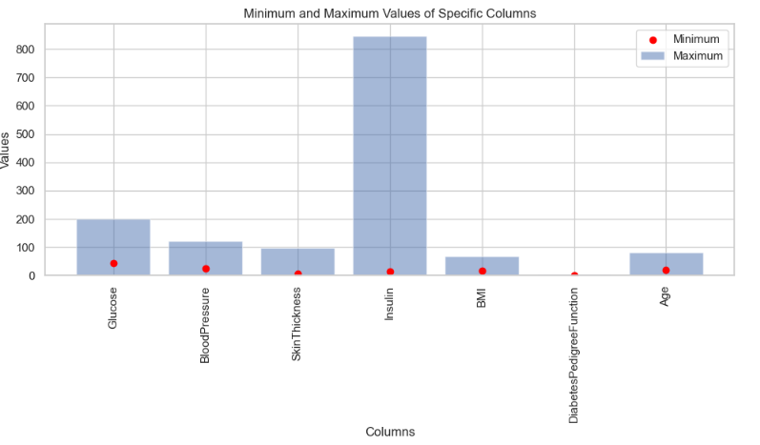
What are the maximum and minimum values for each selected column, and how do they compare visually?
T
0

Slide 20
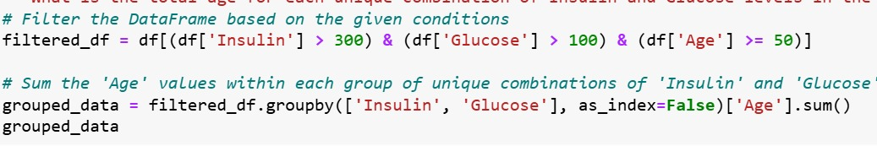
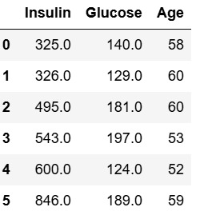
What is the total age for each unique combination of Insulin and Glucose levels in the dataset?
Output
T
0

Slide 21
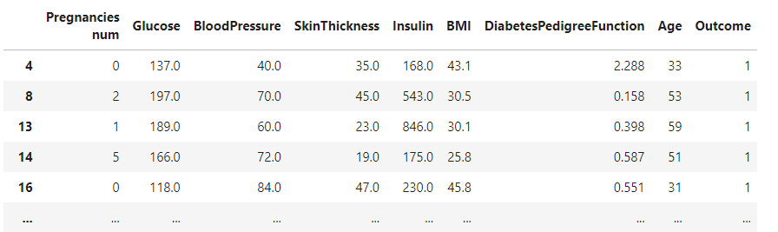
Which records in the dataset correspond to individuals over 20 years old with insulin levels above the mean, who have a positive outcome?
Output

Slide 22
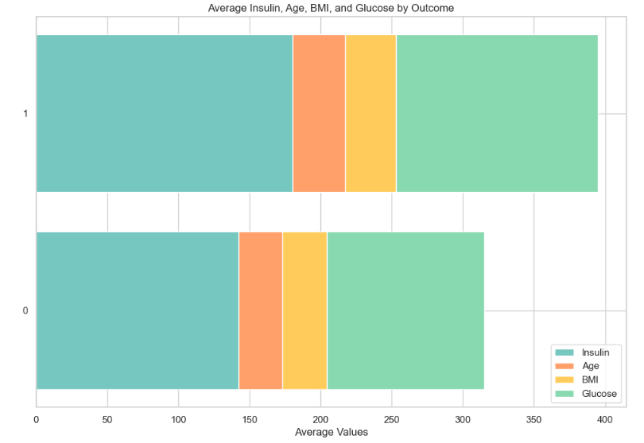
What are the average values of Insulin, Age, BMI, and Glucose for each outcome, and how do they compare visually?
Output

Slide 23
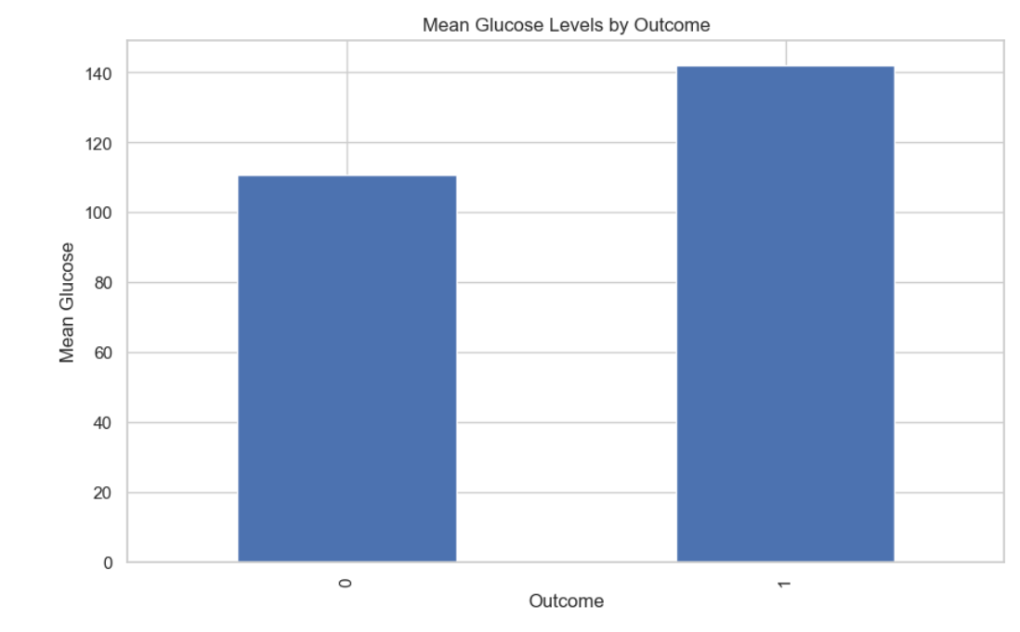
What are the mean glucose levels for each outcome, and how do they compare visually?
Output

Slide 24
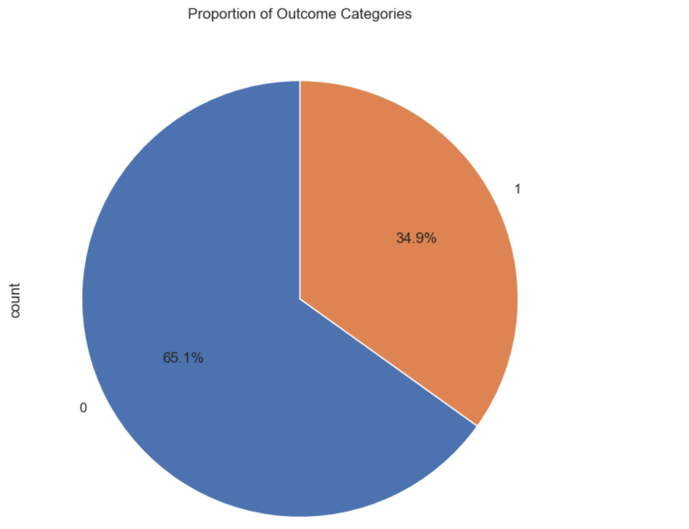
What is the proportion of each category in the 'Outcome' column, and how are these proportions distributed?
T
0

Slide 25
Thanks!
T
0

